Slide 1
Face Mask Detection using Python, Keras, OpenCV and MobileNet
ahmed alamri tc0020
Naif ganadily qa0272
maan alasali ra0193

Slide 2
The problem:
Pandemic COVID-19, WHO has made wearing masks compulsory.
Some people in public places do not take precautions.

Slide 3
The Potential of the Face Mask:
The COVID-19 mask detector we’re building here today could potentially be used to help ensure your safety and the safety of others.
Detecting whether person is wearing a mask or not.

Slide 4
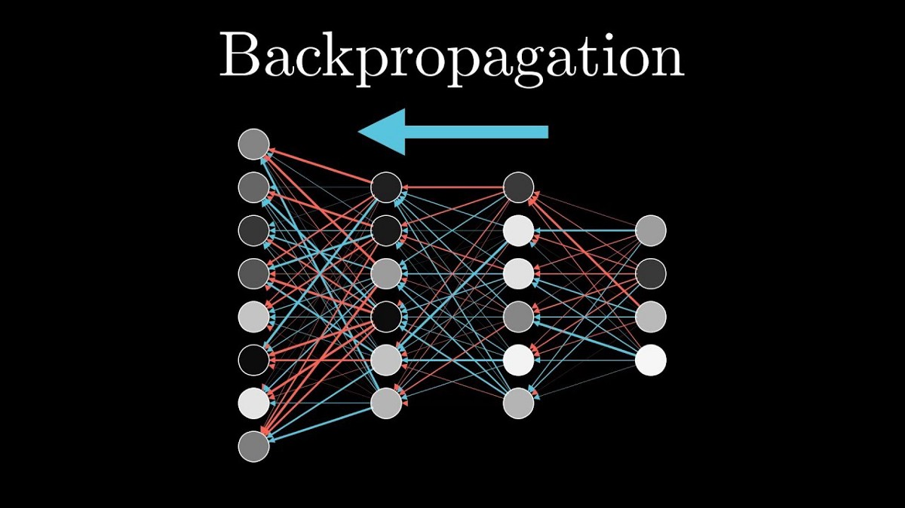
Backpropagation (Algorithm)
In machine learning, backpropagation is a widely used algorithm for training feedforward neural networks. Generalizations of backpropagation exist for other artificial neural networks, and for functions generally.

Slide 5
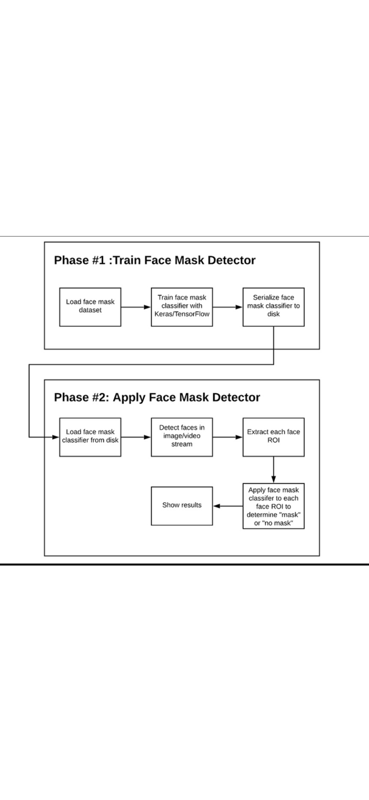

Slide 6
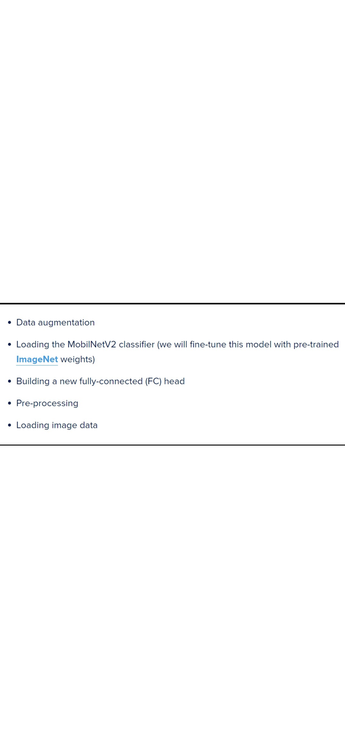

Slide 7
Step one: Install The Dependencies.
Required libraries:
tensorflow>=1.15.2
keras==2.3.1
imultils==0.5.3
numpy==1.18.2
opencv-python==4.2.0.*
matplotib==3.2.1
argparse==1.1
scipy==1.4.1

Slide 8
STEP 2: Let’s A take a look at dataset
Inside the dataset folder there will be two folders:
1- with_mask
With mask contain all images of people wearing masks on.
2- without_mask

Slide 9
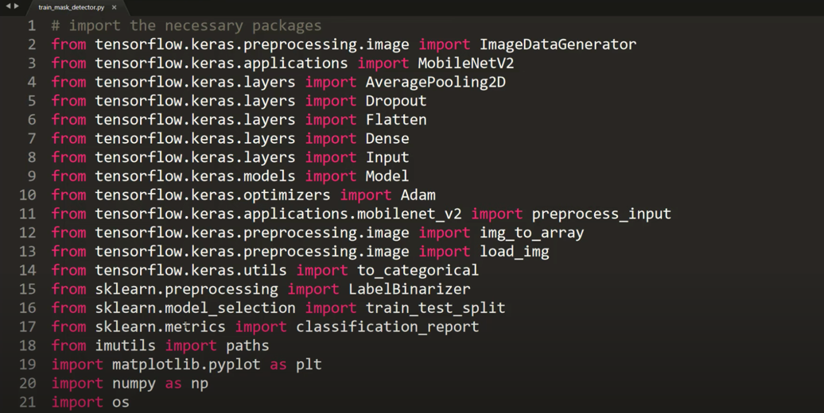
STEP 3: Data Preprocessing
In this part we will convert all the images from both folders with-without mask.
These are the imports:

Slide 10
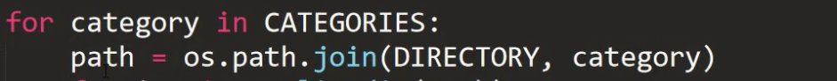
STEP 3: Data Preprocessing count.
There is directory and categories:
Inside directory I mentioned where is my data folders are actually present.
Inside the category: I’m having 2 values with-without mask
And I just mentioned the print(“[INFO] loading images. . .” )
And there are two lists I operated two lists
1- data= [ ] , inside Data I’ll attach all the images inside this data list
2- labels=[ ] , inside the labels list I’ll append all those corresponding with-without masks basically they contain the label of those images are with & without mask.
Go to —> path = os.path.join(directory , category)
Once data is done I get the path of this particular with mask and without mask.

Slide 11
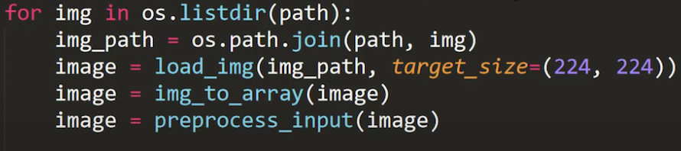
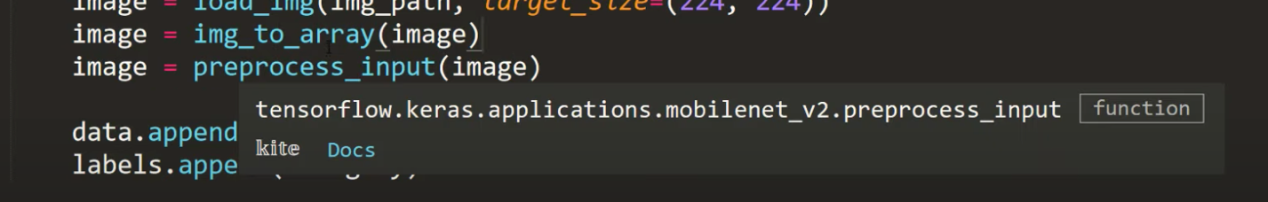
word listdir:
It’s kind of images hold inside that particular directory so with mask there is around thousand and nine images which will listdir by this particular so. listdir method.After I’ll be joining the paths to this particular with mask corresponding image.
Onc I’m done I’ll call the function called”load_img”
So, this “load_img is coming from the keras processing
Inside keras there a function called load img

Slide 12
STEP 3: Data Preprocessing count.
Once I load the image I just save it and now convert to an array using img_to_array function.
This image to array coming from the keras
Once I convert the function to array and then I’ll use
image = preprocess_input(image)
Once we convert our pictures successfully then open our image in [ data.append(image) ] once that is done need to open the corresponding labels inside this labels
With and without masks.

Slide 13
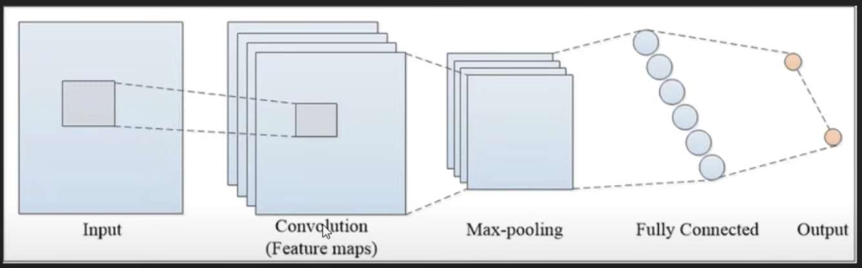
STEP4: Training
We are going to follow the “CONVOLUTION NUERAL NETWORK”
Mobil nets are very faster in process when compared to CONVOLUTION NUERAL NETWORKS AND MOBIL NETS uses lesser parameters.

Slide 14
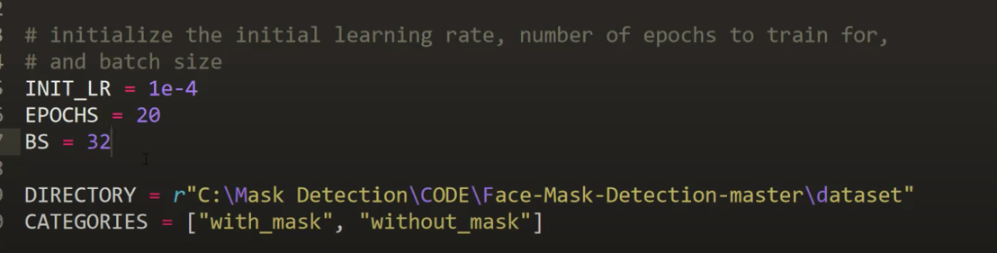
STEP4: Training count.
giving the initial rate to INIT_LR = 1e-4
always make sure your learning rate is less so your when your learning that is less your loss will be calculated properly which means you will get the better accuracy.
my learning to be 0.0001 and given 20 epochs my back size size 32
these values to get a better result.

Slide 15
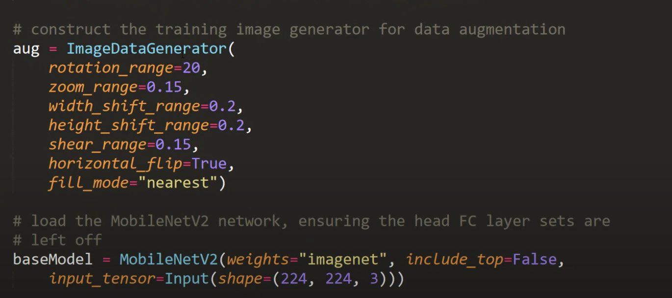
STEP4: Training count.
Image data generator kind accommodations so it creates many images with a single image by adding various properties like flipping rotating the image the image and many other properties to the can create more data set.
rotation angle is 20
zoom range is 0.15

Slide 16
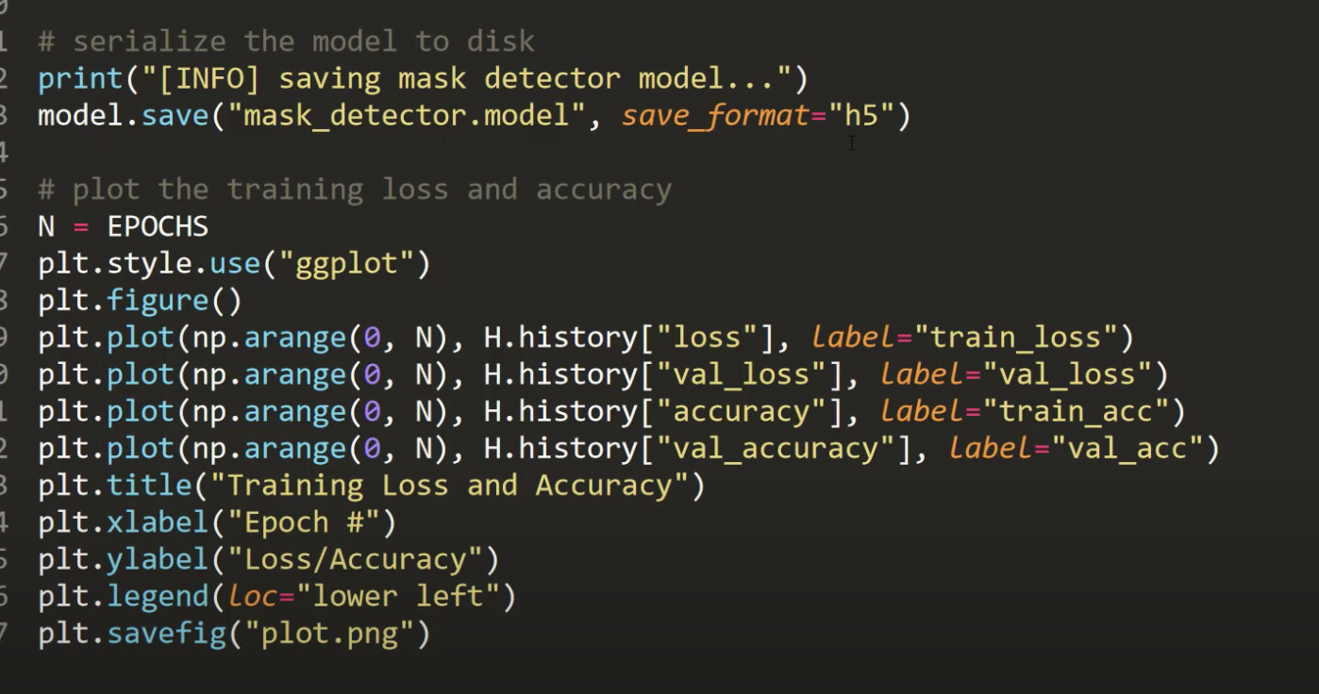
STEP4: Training count.
what we are doing as we are saying the model that we generated now and we are saying it in the h5 format and finally what we do is we are going to plot accuracy and a matrix by using matplotlib.

Slide 17
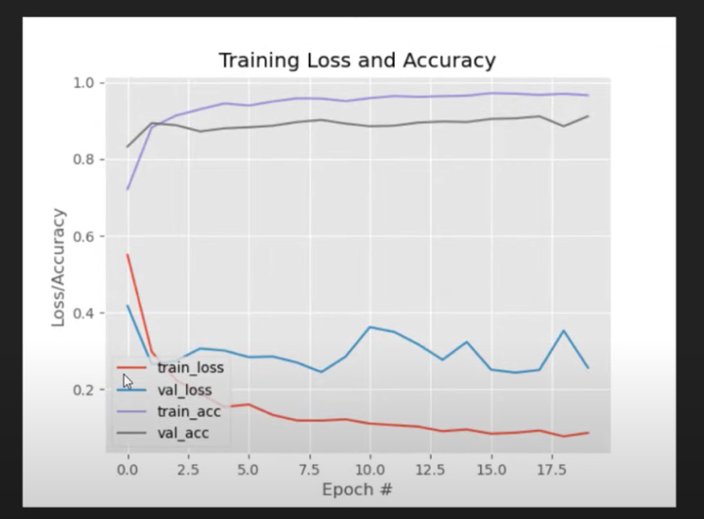
STEP 5: Run View The Accuracy:
According the plot the model is pretty good at the moment.

Slide 18
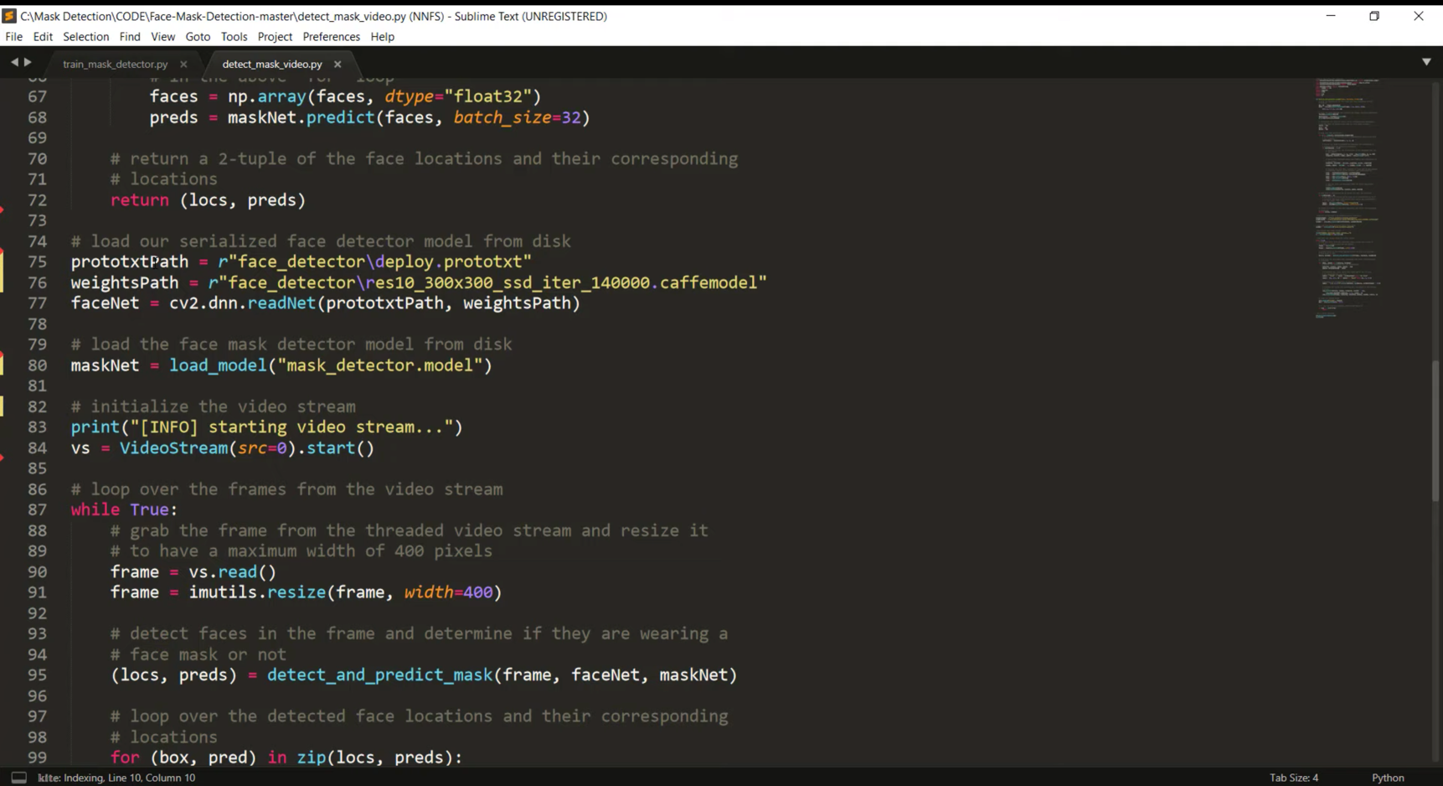
STEP 6: Apply The Model In Camera

Slide 19
STEP 6: Apply The Model In Camera count.
IN ORDER TO USE THEM WE HAVE TO USE A METHOD CALLED READ NET WHICH IS UNDER CV2 AND THE MODEL CALLED DNN
DNN STANDS FOR = DEEP NEURAL NETWORKS
CV2 RECENTLY DEVELOP DNN IN MANY USING METHODS.
WE CAN USE THIS PARTICULAR “FACENET’ TO DETECT FACES.
WE ARE LOADING OUR MODEL USING “LOAD MODEL”
THE MODEL WE USE FOR FACE DETECTION
THIS IS THE MODEL THAT WE ACTUALLY DEVELOP.

Slide 20
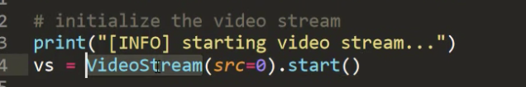
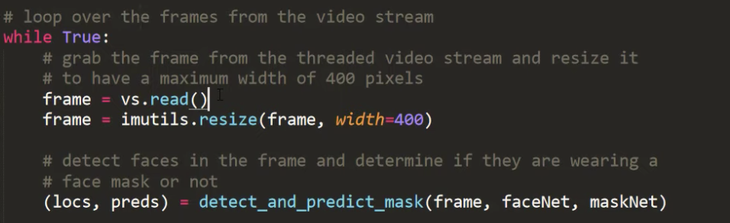
STEP 6: Apply The Model In Camera count.
AND NOW WE HAVE THE T]MODELS FOR FACE DETECTION AND MASK DETECTION.
NEXT THING WE NEED TO DO IS TO LOAD THE CAMERA
IN ORDER TO DO THAT WE ARE USING VIDEO STREAM
INSIDE THIS VIDEO STREAM FUNCTION THERE IS SOMETHING CALLED “SRC=0” IF YOU HAVE MORE THAN A CAMER THE ZERO
WILL CHANGE TO HOW MANY CAMERAS ARE USED.
AND START ACTUALLY LOADS THE CAMERA.
AND THEN WE WILL GO TO THE “WHILE TRUE”
HERE WE ARE READING THE FRAME
SO EVERY FRAME IS NOTHING BUT AN IMAGE.

Slide 21
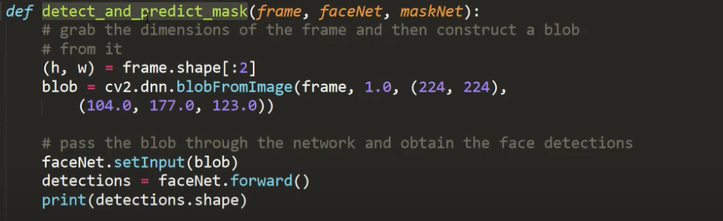
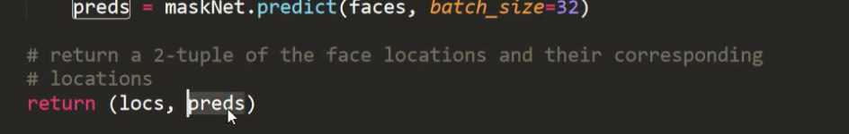
STEP 6: Apply The Model In Camera count.
AND NOW HE HAVE “ FACE NET , MASK NET , FRAME ”
FACE NET: FOR FACE DETECTION
MASK NET: FOR MASK DETECTION
FRAME: FOR THE VIDEO LOADING FROM THE CAMERA
AFTER WE HAVE ALL THIS WE WILL DEFINE A FUNCTION
“CALLED DEFINE AND PREDICT MASK”
WITH THESE THREE ARGUMENTS AND WE JUST DO NORMAL MANIPULATIONS HERE AND RETURN BACK TO RETURN

Slide 22
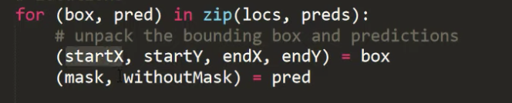
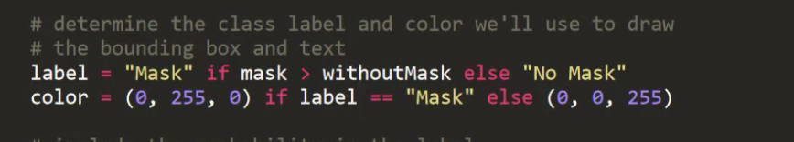
STEP 6: Apply The Model In Camera count.
LOCS = IS NOTHING BUT X AND Y COORDINATES OF PARTICULAR RECTANGLE THAT IS GOING TO SURROUNDING THE FACE.
PREDS = IS THE PREDICTIONS OF THE PERSON WEARING THE MASK OR NOT AND IT CAN BE AS PERCENTAGES.
NOW WE GET THE X,Y AS FOR EXAMPLE
(T X1,Y1 , X2,Y2) WITH THESE POINTS WE WILL DRAW WE WILL DRAW THE RECTANGLE
AND WITH THE PREDICTIONS
LABEL = “MASK” IS MASK > WITHOUTMASK ELSE “NO MASK”
AND FOR COLOR WE WILL CHOOSE B , G AND R
0= IS THE LEAST VALUE 255= IS HIGHEST VALUE
AS WE SAID B= 0 G= 255 R= 0
THESE COLORS LEAD TO GREEN COLOR
SO GREEN COLOR IF THERE IS MASK
AND IF THERE IS NO MASK WE WILL PUT (0,0,255)
RE IS THE MAXIMUM VALUE HERE I]AND THIS WILL LEADS TO RED.

Slide 23
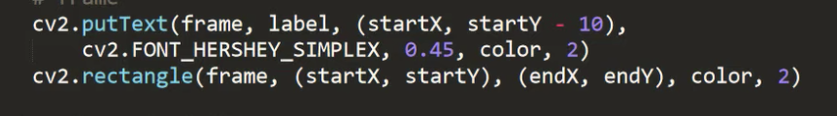
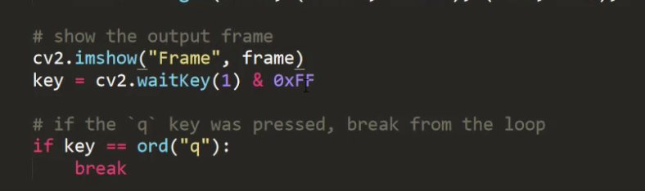
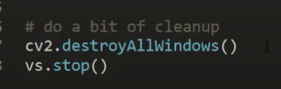
STEP 6: Apply The Model In Camera count.
WE ARE JUST DISPLAYING THE PERCENTAGE OF THE PREDICTION WE HAVE HERE
THE TEXT HERE.
DRAWING THE RECTANGLE
THE FRAME IS THE SEQUENCE OF PICTURES THAT IS GOING TO FLOW THROUGH.
FINALLY WE ARE BREAKING THE WHILE LOOP
WE FINALLY DESTROY ALL THE WINDOWS AND STOP THE VIDEOS

Slide 24
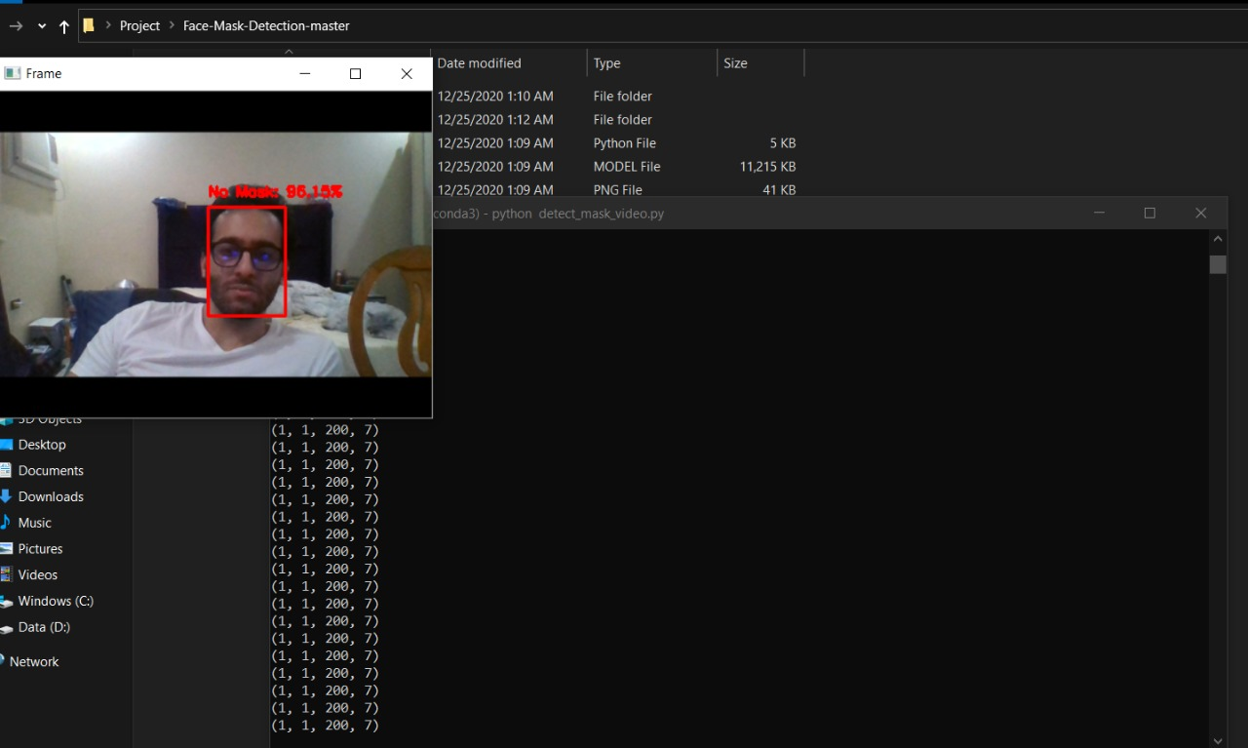
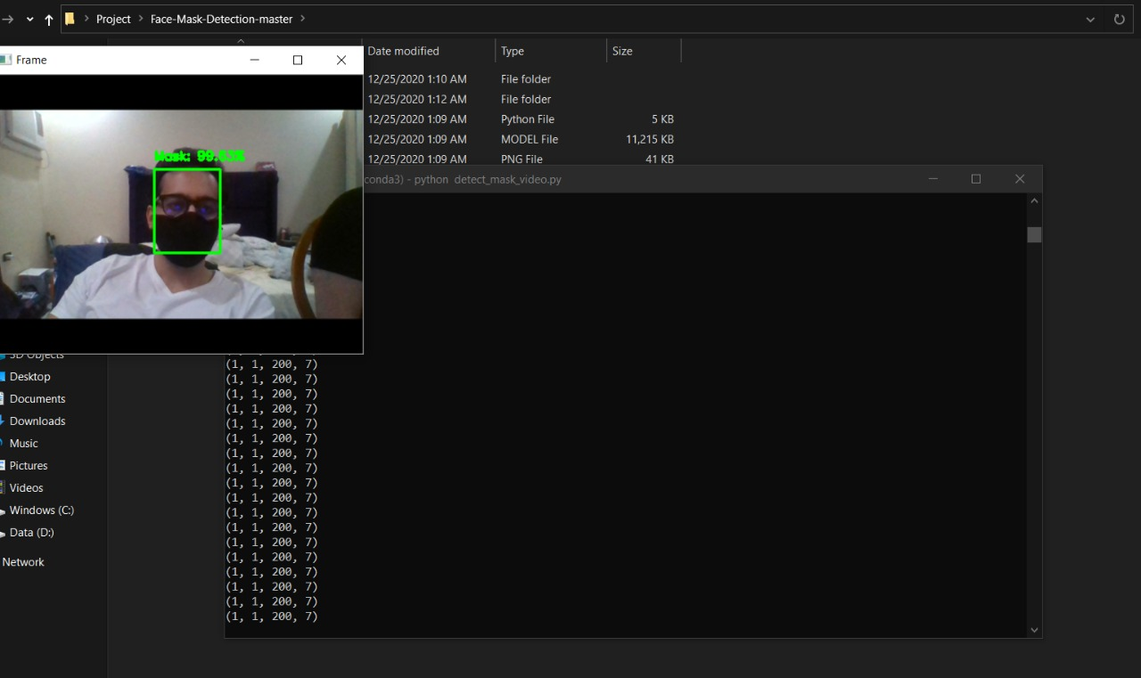
STEP7: Let’s See The Result

